Slide 1
Author: Horstmann Title: Big Java Late Objects
“This material is reproduced with permission of John Wiley & Sons, Inc.”).

Slide 2

8
CHAPTER
OBJECTS AND CLASSES
Slides by Donald W. Smith
TechNeTrain.com
Final Draft
10/30/2011

Slide 3
Chapter Goals
To understand the concepts of classes, objects and encapsulation
To implement instance variables, methods and constructors
To be able to design, implement, and test your own classes
To understand the behavior of object references, static variables and static methods
In this chapter, you will learn how to discover, specify, and implement your own classes, and how to use them in your programs.

Slide 4
Contents
Object-Oriented Programming
Implementing a Simple Class
Specifying the Public Interface of a Class
Designing the Data Representation
Implementing Instance Methods
Constructors
Testing a Class
Problem Solving:
Tracing Objects, Patterns for Object Data
Object References
Static Variables and Methods

Slide 5

8.1 Object-Oriented Programming
You have learned structured programming
Breaking tasks into subtasks
Writing re-usable methods to handle tasks
We will now study Objects and Classes
To build larger and more complex programs
To model objects we use in the world
A class describes objects with the same behavior. For example, a Car class describes all passenger vehicles that have a certain capacity and shape.

Slide 6
Objects and Programs
Java programs are made of objects that interact with each other
Each object is based on a class
A class describes a set of objects with the same behavior
Each class defines a specific set of methods to use with its objects
For example, the String class provides methods:
Examples: length() and charAt() methods
String greeting = “Hello World”;
int len = greeting.length();
char c1 = greeting.charAt(0);

Slide 7
Diagram of a Class
Private Data
Each object has its own private data that other objects cannot directly access
Methods of the public interface provide access to private data, while hiding implementation details:
This is called Encapsulation
Public Interface
Each object has a set of methods available for other objects to use
Class
Private Data
(Variables)
Public Interface
(Methods)

Slide 8

8.2 Implementing a Simple Class
Example: Tally Counter: A class that models a mechanical device that is used to count people
For example, to find out how many people attend a concert or board a bus
What should it do?
Increment the tally
Get the current total

Slide 9
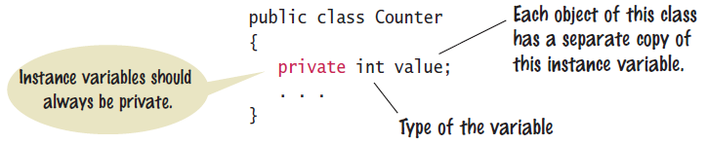
Tally Counter Class
Specify instance variables in the class declaration:
Each object instantiated from the class has its own set of instance variables
Each tally counter has its own current count
Access Specifiers:
Classes (and interface methods) are public
Instance variables are always private

Slide 10
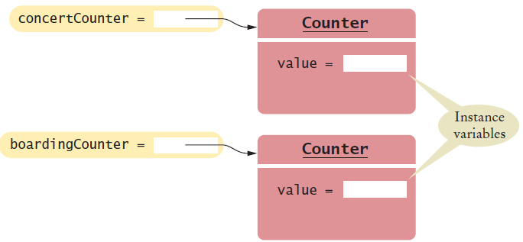
Instantiating Objects
Objects are created based on classes
Use the new operator to construct objects
Give each object a unique name (like variables)
You have used the new operator before:
Creating two instances of Counter objects:
Scanner in = new Scanner(System.in);
Class name
Object name
Class name
Counter concertCounter = new Counter();
Counter boardingCounter = new Counter();
Use the new operator to construct objects of a class.

Slide 11
Tally Counter Methods
Design a method named count that adds 1 to the instance variable
Which instance variable?
Use the name of the object
concertCounter.count()
boardingCounter.count()
public class Counter
{
private int value;
public void count()
{
value = value + 1;
}
public int getValue()
{
return value;
}
}

Slide 12
8.3 Public Interface of a Class
When you design a class, start by specifying the public interface of the new class
Example: A Cash Register Class
What tasks will this class perform?
What methods will you need?
What parameters will the methods need to receive?
What will the methods return?
Task | Method | Returns
Add the price of an item | addItem(double) | void
Get the total amount owed | getTotal() | double
Get the count of items purchased | getCount() | int
Clear the cash register for a new sale | clear() | void

Slide 13
Writing the Public Interface
/**
A simulated cash register that tracks the item count
and the total amount due.
*/
public class CashRegister
{
/**
Adds an item to this cash register.
@param price: the price of this item
*/
public void addItem(double price)
{
// Method body
}
/**
Gets the price of all items in the current sale.
@return the total price
*/
public double getTotal() ...
Javadoc style comments document the class and the behavior of each method
The method declarations make up the public interface of the class
The data and method bodies make up the private implementation of the class

Slide 14
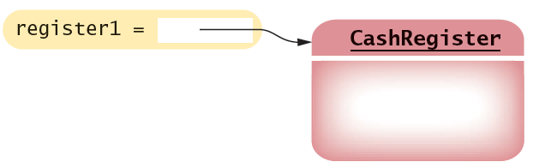
Non-static Methods Means…
We have been writing class methods using the static modifier:
For non-static (instance) methods, you must instantiate an object of the class before you can invoke methods
Then invoke methods of the object
public static void addItem(double val)
public void addItem(double val)
public static void main(String[] args)
{
// Construct a CashRegister object
CashRegister register1 = new CashRegister();
// Invoke a non-static method of the object
register1.addItem(1.95);
}

Slide 15
Accessor and Mutator Methods
Many methods fall into two categories:
1) Accessor Methods: 'get' methods
Asks the object for information without changing it
Normally return a value of some type
2) Mutator Methods: 'set' methods
Changes values in the object
Usually take a parameter that will change an instance variable
Normally return void
public double getTotal() { }
public int getCount() { }
public void addItem(double price) { }
public void clear() { }

Slide 16
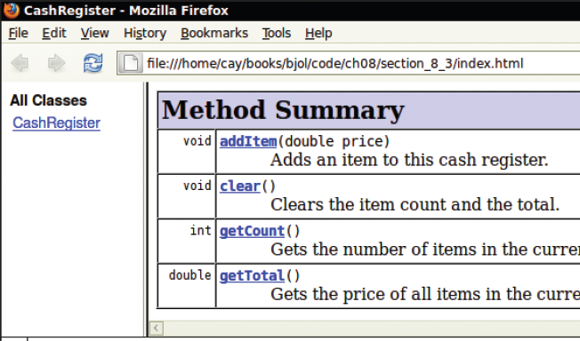
Special Topic 8.1: Javadoc
The Javadoc utility generates a set of HTML files from the Javadoc style comments in your source code
Methods document parameters and returns:
@param
@return

Slide 17
8.4 Designing the Data Representation
An object stores data in instance variables
Variables declared inside the class
All methods inside the class have access to them
Can change or access them
What data will our CashRegister methods need?
Task | Method | Data Needed
Add the price of an item | addItem() | total, count
Get the total amount owed | getTotal() | total
Get the count of items purchased | getCount() | count
Clear the cash register for a new sale | clear() | total, count
An object holds instance variables that are accessed by methods

Slide 18

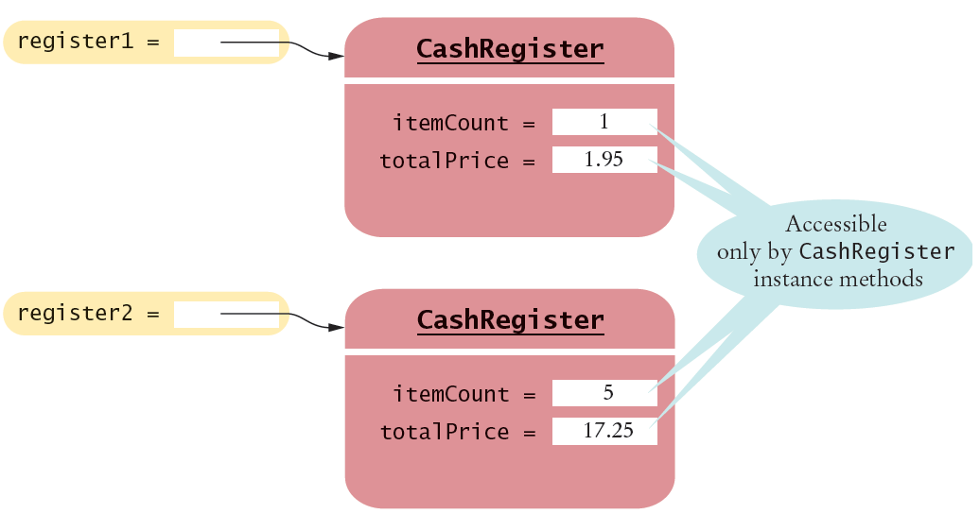
Instance Variables of Objects
Each object of a class has a separate set of instance variables.
The values stored in instance variables make up the state of the object.

Slide 19
Accessing Instance Variables
private instance variables cannot be accessed from methods outside of the class
public static void main(String[] args)
{
. . .
System.out.println(register1.itemCount); // Error
. . .
}
The compiler will not allow this violation of privacy
Use accessor methods of the class instead!
public static void main(String[] args)
{
. . .
System.out.println( register1.getCount() ); // OK
. . .
}
Encapsulation provides a public interface and hides the implementation details.

Slide 20
8.5 Implementing Instance Methods
Implement instance methods that will use the private instance variables
public void addItem(double price)
{
itemCount++;
totalPrice = totalPrice + price;
}
Task | Method | Returns
Add the price of an item | addItem(double) | void
Get the total amount owed | getTotal() | double
Get the count of items purchased | getCount() | int
Clear the cash register for a new sale | clear() | void

Slide 21
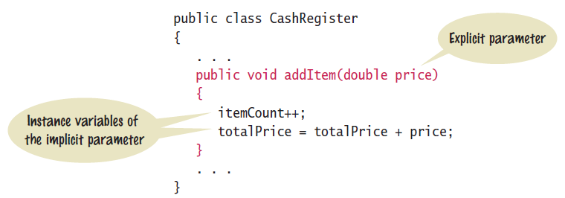
Syntax 8.2: Instance Methods
Use instance variables inside methods of the class
There is no need to specify the implicit parameter (name of the object) when using instance variables inside the class
Explicit parameters must be listed in the method declaration

Slide 22
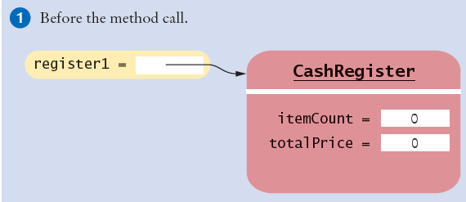
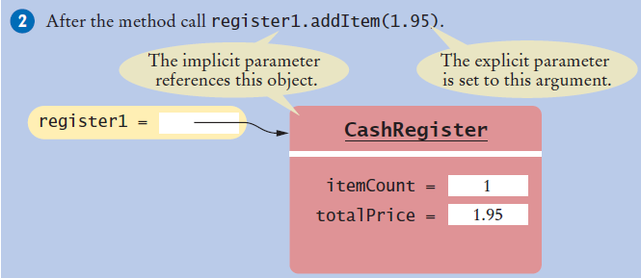
Implicit and Explicit Parameters
When an item is added, it affects the instance variables of the object on which the method is invoked
The object on which a method is applied is the implicit parameter

Slide 23
8.6 Constructors
A constructor is a method that initializes instance variables of an object
It is automatically called when an object is created
It has exactly the same name as the class
public class CashRegister
{
. . .
/**
Constructs a cash register with cleared item count and total.
*/
public CashRegister() // A constructor
{
itemCount = 0;
totalPrice = 0;
}
}
Constructors never return values, but do not use void in their declaration

Slide 24
Multiple Constructors
A class can have more than one constructor
Each must have a unique set of parameters
public class BankAccount
{
. . .
/**
Constructs a bank account with a zero balance.
*/
public BankAccount( ) { . . . }
/**
Constructs a bank account with a given balance.
@param initialBalance the initial balance
*/
public BankAccount(double initialBalance) { . . . }
}
The compiler picks the constructor that matches the construction parameters.
BankAccount joesAccount = new BankAccount();
BankAccount lisasAccount = new BankAccount(499.95);

Slide 25
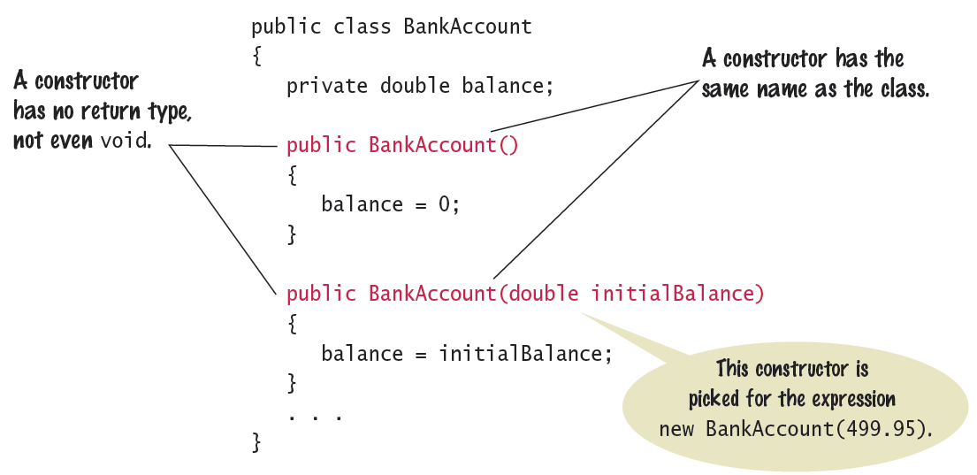
Syntax 8.3: Constructors
One constructors is invoked when the object is created with the new keyword

Slide 26
The Default Constructor
If you do not supply any constructors, the compiler will make a default constructor automatically
It takes no parameters
It initializes all instance variables
public class CashRegister
{
. . .
/**
Does exactly what a compiler generated constructor would do.
*/
public CashRegister()
{
itemCount = 0;
totalPrice = 0;
}
}
By default, numbers are initialized to 0, booleans to false, and objects as null.

Slide 27
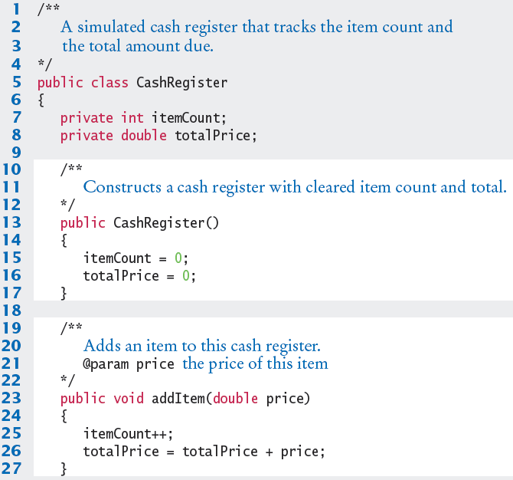
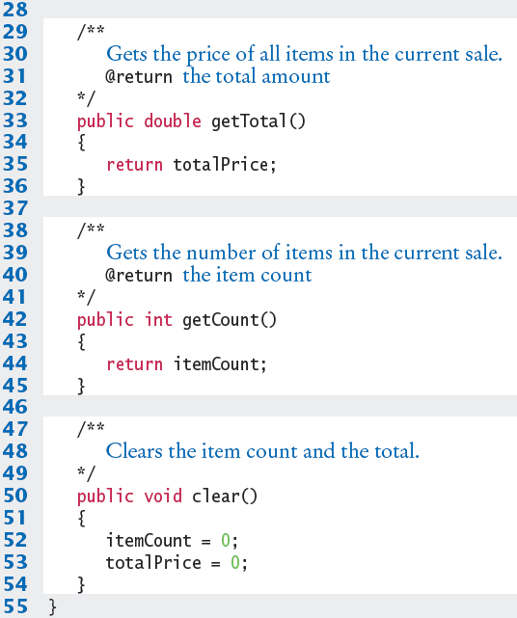
CashRegister.java

Slide 28

Common Error 8.1
Not initializing object references in constructor
References are by default initialized to null
Calling a method on a null reference results in a runtime error: NullPointerException
The compiler catches uninitialized local variables for you
public class BankAccount
{
private String name; // default constructor will set to null
public void showStrings()
{
String localName;
System.out.println(name.length());
System.out.println(localName.length());
}
}
Runtime Error: java.lang.NullPointerException
Compiler Error: variable localName might not have been initialized

Slide 29
Common Error 8.2
Trying to Call a Constructor
You cannot call a constructor like other methods
It is ‘invoked’ for you by the new reserved word
You cannot invoke the constructor on an existing object:
But you can create a new object using your existing reference
CashRegister register1 = new CashRegister();
register1.CashRegister(); // Error
CashRegister register1 = new CashRegister();
Register1.newItem(1.95);
CashRegister register1 = new CashRegister();

Slide 30
Common Error 8.3
Declaring a Constructor as void
Constructors have no return type
This creates a method with a return type of void which is NOT a constructor!
The Java compiler does not consider this an error
public class BankAccount
{
/**
Intended to be a constructor.
*/
public void BankAccount( )
{
. . .
}
}
Not a constructor…. Just another method that returns nothing (void)

Slide 31

Special Topic 8.2
Overloading
We have seen that multiple constructors can have exactly the same name
They require different lists of parameters
Actually any method can be overloaded
Same method name with different parameters
We will not be using overloading in this book
Except as required for constructors
void print(CashRegister register) { . . . }
void print(BankAccount account) { . . . }
void print(int value) { . . . }
Void print(double value) { . . . }

Slide 32
8.7 Testing a Class
We wrote a CashRegister class but…
You cannot execute the class – it has no main method
It can become part of a larger program
Test it first though with unit testing
To test a new class, you can use:
Programming tools that interactively create objects:
DrJava: www.drjava.org
BlueJ: www.bluej.org
Or write a tester class:
With a main
public class CashRegisterTester
{
public static void main(String[] args)
{
CashRegister c1 = new CashRegister();
...

Slide 33
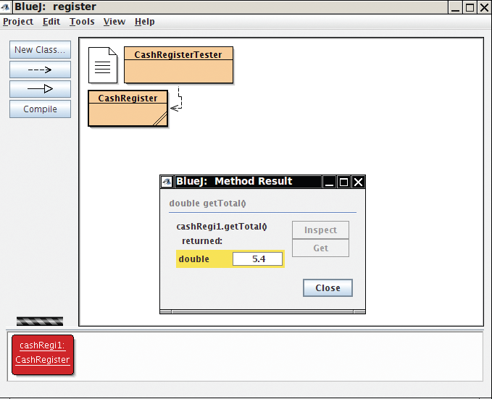
BlueJ: An IDE for Testing
BlueJ can interactively instantiate objects of a class, and allows you to invoke their methods
Great for testing!

Slide 34
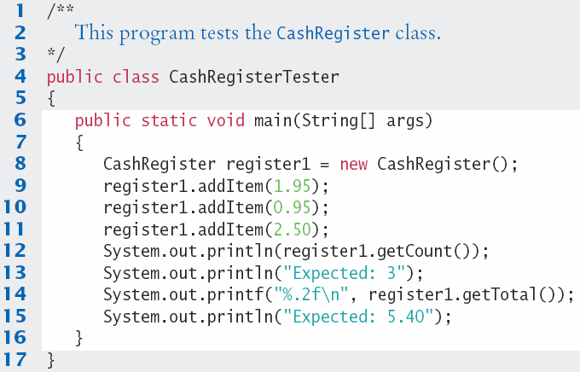
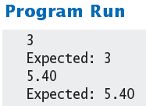
CashRegisterTester.java
Test all methods
Print expected results
Output actual results
Compare results
A unit test verifies that a class works correctly in isolation, outside a complete program.

Slide 35

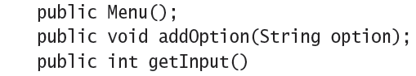
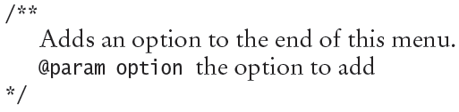
Steps to Implementing a Class
1) Get an informal list of responsibilities for your objects
2) Specify the public interface
3) Document the public interface
Javadoc comments

Slide 36
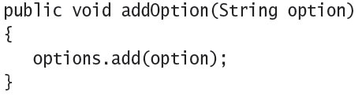
Steps to Implementing a Class
4) Determine the instance variables
5) Implement constructors and methods
6) Test your class

Slide 37
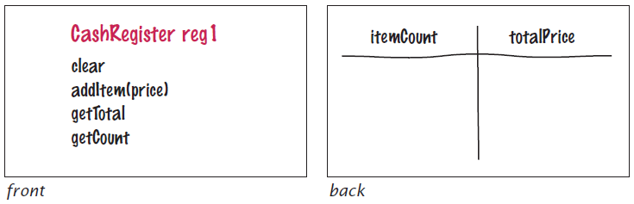
8.8 Problem Solving: Tracing Objects
Use an Index card for each object
An object is manipulated through the public interface (front of the card)
The encapsulated data is on the back of the card

Slide 38
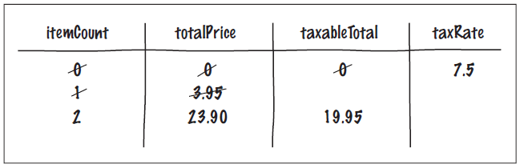
Mutator Methods and Cards
As mutator methods are called, keep track of the value of instance variables
CashRegister reg2(7.5); // 7.5 percent sales tax
reg2.addItem(3.95, false); // Not taxable
reg2.addItem(19.95, true); // Taxable

Slide 39
8.9 Problem Solving
Patterns for Object Data
Common patterns when designing instance variables
Keeping a Total
Counting Events
Collecting Values
Managing Object Properties
Modeling Objects with Distinct States
Describing the Position of an Object

Slide 40
Patterns: Keeping a Total
Examples
Bank account balance
Cash Register total
Car gas tank fuel level
Variables needed
Total (totalPrice)
Methods Required
Add (addItem)
Clear
getTotal
public class CashRegister
{
private double totalPrice;
public void addItem(double price)
{
totalPrice += price;
}
public void clear()
{
totalPrice = 0;
}
public double getTotal()
{
return totalPrice;
}
}

Slide 41
Patterns: Counting Events
Examples
Cash Register items
Bank transaction fee
Variables needed
Count
Methods Required
Add
Clear
Optional: getCount
public class CashRegister
{
private double totalPrice;
private int itemCount;
public void addItem(double price)
{
totalPrice += price;
itemCount++;
}
public void clear()
{
totalPrice = 0;
itemCount = 0;
}
public double getCount()
{
return itemCount;
}
}

Slide 42
Patterns: Collecting Values
Examples
Multiple choice question
Shopping cart
Storing values
Array or ArrayList
Constructor
Initialize to empty collection
Methods Required
Add
public class Cart
{
private String[] items;
private int itemCount;
public Cart() // Constructor
{
items = new String[50];
itemCount = 0;
}
public void addItem(String name)
{
if(itemCount < 50)
{
items[itemCount] = name;
itemCount++;
}
}
}

Slide 43
Patterns: Managing Properties
A property of an object can be set and retrieved
Examples
Student: name, ID
Constructor
Set a unique value
Methods Required
set
get
public class Student
{
private String name;
private int ID;
public Student(int anID)
{
ID = anID;
}
public void setName(String newname)
{
if (newName.length() > 0)
name = newName;
}
public getName()
{
return name;
}
}

Slide 44

Patterns: Modeling Stateful Objects
Some objects can be in one of a set of distinct states.
Example: A fish
Hunger states:
Somewhat Hungry
Very Hungry
Not Hungry
Methods will change the state
eat
move
public class Fish
{
private int hungry;
public static final int NOT_HUNGRY = 0;
public static final int SOMEWHAT_HUNGRY = 1;
public static final int VERY_HUNGRY = 2;
public void eat()
{
hungry = NOT_HUNGRY;
}
public void move()
{
if (hungry < VERY_HUNGRY)
{ hungry++; }
}

Slide 45

Patterns: Object Position
Examples
Game object
Bug (on a grid)
Cannonball
Storing values
Row, column, direction, speed. . .
Methods Required
move
turn
public class Bug
{
private int row;
private int column;
private int direction;
// 0 = N, 1 = E, 2 = S, 3 = W
public void moveOneUnit()
{
switch(direction) {
case 0: row--; break;
case 1: column++; break;
. . .
}
}
}

Slide 46

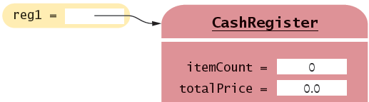
8.10 Object References
Objects are similar to arrays because they always have reference variables
Array Reference
Object Reference
double[] values = new double[5];
CashRegister reg1 = new CashRegister;
An object reference specifies the memory location of the object

Slide 47
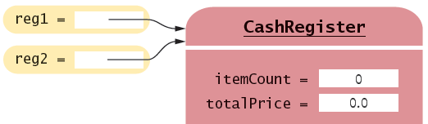
Shared References
Multiple object variables may contain references to the same object.
Single Reference
Shared References
CashRegister reg1 = new CashRegister;
CashRegister reg2 = reg1;
The internal values can be changed through either reference

Slide 48
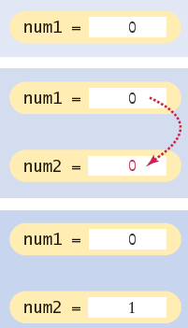
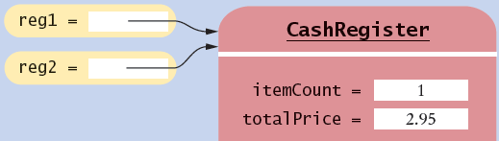
Primitive versus Reference Copy
Primitive variables can be copied, but work differently than object references
Primitive Copy Reference Copy
Two locations One location for both
int num1 = 0;
int num2 = num1;
num2++;
CashRegister reg1 = new CashRegister;
CashRegister reg2 = reg1;
reg2.addItem(2.95);
Why? Primitives take much less storage space than objects!

Slide 49
The null reference
A reference may point to ‘no’ object
You cannot invoke methods of an object via a null reference – causes a run-time error
To test if a reference is null before using it:
CashRegister reg = null;
System.out.println(reg.getTotal()); // Runtime Error!
String middleInitial = null; // No middle initial
if (middleInitial == null)
System.out.println(firstName + " " + lastName);
else
System.out.println(firstName + " " + middleInitial + ". " + lastName);

Slide 50
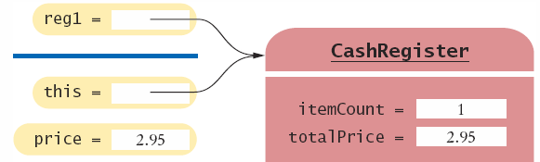
The this reference
Methods receive the ‘implicit parameter’ in a reference variable called ‘this’
It is a reference to the object the method was invoked on:
It can clarify when instance variables are used:
void addItem(double price)
{
this.itemCount++;
this.totalPrice = this.totalPrice + price;
}

Slide 51
Constructor this reference
Sometimes people use the this reference in constructors
It makes it very clear that you are setting the instance variable:
public class Student
{
private int id;
private String name;
public Student(int id, String name)
{
this.id = id;
this.name = name;
}
}

Slide 52

8.11 Static Variables and Methods
Variables can be declared as static in the Class declaration
There is one copy of a static variable that is shared among all objects of the Class
public class BankAccount
{
private double balance;
private int accountNumber;
private static int lastAssignedNumber = 1000;
public BankAccount()
{
lastAssignedNumber++;
accountNumber = lastAssignedNumber;
}
. . .
}
Methods of any object of the class can use or change the value of a static variable

Slide 53
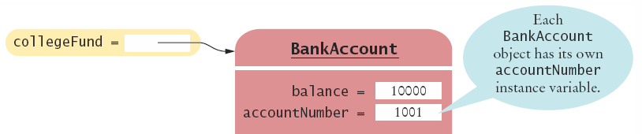
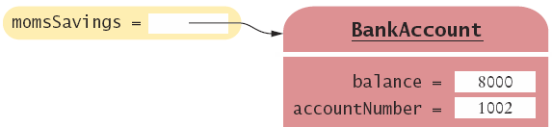
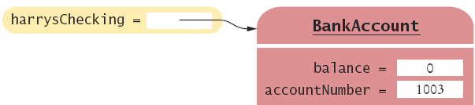
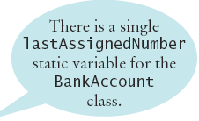
Using Static Variables
Example:
Each time a new account is created, the lastAssignedNumber variable is incremented by the constructor
Access the static variable using:
ClassName.variableName

Slide 54
Using Static Methods
The Java API has many classes that provide methods you can use without instantiating objects
The Math class is an example we have used
Math.sqrt(value) is a static method that returns the square root of a value
You do not need to instantiate the Math class first
Access static methods using:
ClassName.methodName()

Slide 55
Writing your own Static Methods
You can define your own static methods
public class Financial
{
/**
Computes a percentage of an amount.
@param percentage the percentage to apply
@param amount the amount to which the percentage is applied
@return the requested percentage of the amount
*/
public static double percentOf(double percentage, double amount)
{
return (percentage / 100) * amount;
}
}
static methods usually return a value. They can only access static variables and methods.
Invoke the method on the Class, not an object
double tax = Financial.percentOf(taxRate, total);

Slide 56
Summary: Classes and Objects
A class describes a set of objects with the same behavior.
Every class has a public interface: a collection of methods through which the objects of the class can be manipulated.
Encapsulation is the act of providing a public interface and hiding the implementation details.
Encapsulation enables changes in the implementation without affecting users of a class

Slide 57
Summary: Variables and Methods
An object’s instance variables store the data required for executing its methods.
Each object of a class has its own set of instance variables.
An instance method can access the instance variables of the object on which it acts.
A private instance variable can only be accessed by the methods of its own class.
Variables declared as static in a class have a single copy of the variable shared among all of the instances of the class.

Slide 58
Summary: Method Headers, Data
Method Headers
You can use method headers and method comments to specify the public interface of a class.
A mutator method changes the object on which it operates.
An accessor method does not change the object on which it operates.
Data Declaration
For each accessor method, an object must either store or compute the result.
Commonly, there is more than one way of representing the data of an object, and you must make a choice.
Be sure that your data representation supports method calls in any order.

Slide 59
Summary: Parameters, Constructors
Methods Parameters
The object on which a method is applied is the implicit parameter.
Explicit parameters of a method are listed in the method declaration.
Constructors
A constructor initializes the object’s instance variables
A constructor is invoked when an object is created with the new operator.
The name of a constructor is the same as the class
A class can have multiple constructors.
The compiler picks the constructor that matches the construction arguments.

